Slide 1

Selenium on Google Cloud Platform (GCP)
Presenter:
Verma Mohit
Notes:
I am presenting my applied research on Selenium in Cloud Environments using Google Cloud Platform. This research focuses on deploying Selenium Grid on GCP to optimize testing performance and scalability.

Slide 2
Introduction:
Key Components:
Automated testing is essential for modern software development.
Selenium is a popular open-source test automation framework.
This research focuses on deploying Selenium Grid on GCP using Virtual Machines (VMs) and integrating it with Jenkins for CI/CD.
Goals: Cost efficiency, and test execution performance.
Notes:
Automated testing has become a key part of software development, ensuring rapid feedback and efficiency. Selenium, an open-source framework, is widely used for web application testing. In this study, we will deploy Selenium Grid on GCP and integrate it with Jenkins to enhance performance and scalability.

Slide 3
Research Objectives & Questions
Deployment & Configuration: How can Selenium Grid be effectively deployed on GCP?
Performance Optimization: How can we monitor and optimize Selenium test execution in cloud environments?
Scalability & Reliability: What best practices ensure a scalable and cost-effective test automation solution?
Notes:
This research aims to answer key questions, including how to deploy Selenium Grid efficiently, optimize performance, and ensure scalability and reliability in cloud environments. These objectives guide our approach to making Selenium testing more robust and cost-effective.

Slide 4
Technologies & Tools
Testing Framework: Selenium WebDriver, Selenium Grid
Cloud Platform: Google Cloud Platform (GCP)
Containerization: Docker
CI/CD Tools: Jenkins, GitLab CI, GitHub Actions
Programming Language: Python
Notes:
A variety of technologies support our approach. Selenium WebDriver and Grid facilitate test automation, while GCP provides cloud infrastructure. We use Docker for containerization and Jenkins for CI/CD. Python is the primary programming language due to its flexibility and integration capabilities.

Slide 5
What is Selenium Grid & WebDriver?
Selenium WebDriver: A tool for automating web applications by simulating user actions.
Selenium Grid: A distributed system that allows parallel test execution on multiple machines, browsers, and operating systems.
Key Features:
Remote execution of tests
Load balancing for tests
Parallel testing for efficiency
Notes:
Selenium WebDriver is the core tool for automating browser interactions. Selenium Grid extends WebDriver's capabilities by allowing distributed testing across multiple machines. It enables parallel execution, reducing test run time and improving efficiency.

Slide 6
What is Google Cloud Platform (GCP)?
GCP is a suite of cloud computing services offered by Google.
Key Services:
Compute Engine (VMs for hosting applications)
Kubernetes Engine (Container orchestration)
Cloud Storage (Scalable data storage)
Cloud Monitoring & Logging (Real-time system monitoring and logging)
Used by enterprises for scalability, security, and performance.
Notes:
Google Cloud Platform, or GCP, is a cloud computing service offering a range of tools for hosting, scaling, and managing applications. It provides essential services like virtual machines, storage, and monitoring, making it an ideal choice for deploying automated testing solutions.

Slide 7
Why Use Google Cloud Platform (GCP)?
Scalability: GCP provides auto-scaling infrastructure to support high test loads efficiently.
Cost Optimization: Pay-as-you-go pricing helps reduce testing costs by using resources only when needed.
Performance & Reliability: GCP’s global infrastructure ensures low-latency, high-speed test execution.
Seamless Integration: GCP services such as Compute Engine, Kubernetes Engine, and Cloud Logging simplify deployment and monitoring.
Security: GCP provides built-in security features, including IAM roles and encrypted connections, ensuring safe test execution.
Notes:
We are using Google Cloud Platform because of its scalability, cost-effectiveness, and strong security features. GCP allows us to deploy Selenium Grid efficiently, scale test execution as needed, and integrate seamlessly with monitoring and CI/CD tools. Its pay-as-you-go pricing ensures that we use resources efficiently, optimizing our cloud expenses while maintaining high performance.

Slide 8
Understanding Selenium Grid
Hub: Central server distributing test execution requests.
Nodes: Machines executing test cases on different browsers and OS.
Benefits: Parallel execution, reduced execution time, cross-browser testing, scalability, remote execution.
Notes:
Selenium Grid is a crucial part of our testing setup. The Hub acts as a central controller, distributing tests to various Nodes. This setup enables parallel execution, reduces execution time, and allows cross-browser testing, making it an efficient testing solution.

Slide 9
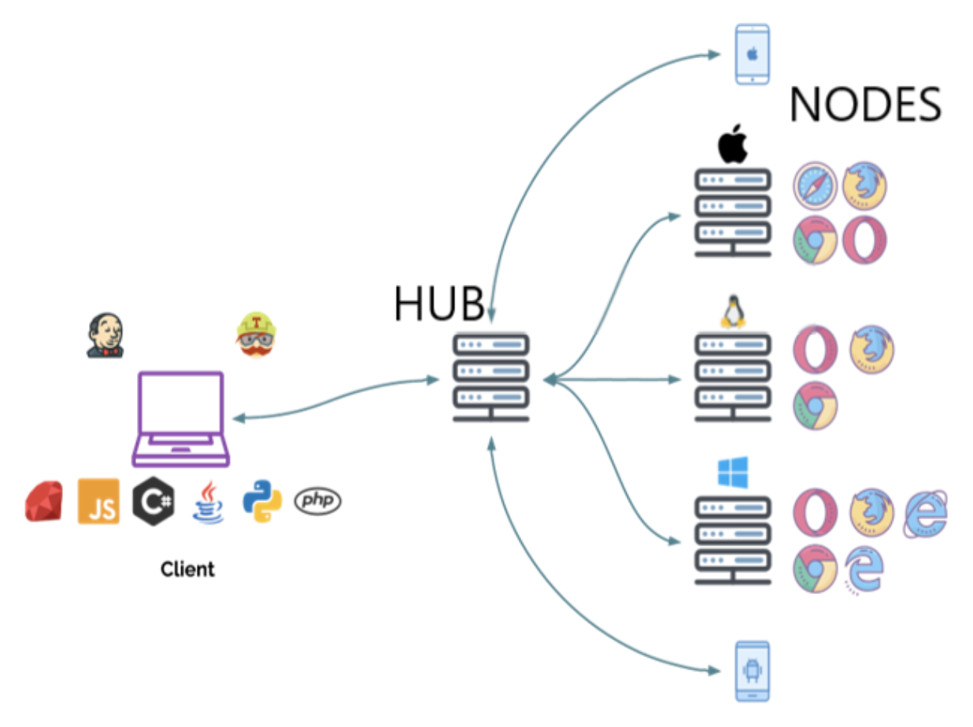
Understanding Selenium Grid
Notes:
Selenium Grid is a crucial part of our testing setup. The Hub acts as a central controller, distributing tests to various Nodes. This setup enables parallel execution, reduces execution time, and allows cross-browser testing, making it an efficient testing solution.

Slide 10
What is Jenkins?
Jenkins is an open-source CI/CD automation tool.
Helps automate test execution, build, and deployment processes.
Features:
Supports integration with Selenium for automated testing.
Configurable pipelines for CI/CD workflows.
Plugin support for enhanced functionality.
Notes:
Jenkins is an essential tool for CI/CD, automating test execution and deployment processes. It seamlessly integrates with Selenium to support continuous testing. Its plugin ecosystem allows extensive customization, making it a valuable asset in automated workflows.

Slide 11
Setting Up Selenium Grid on GCP
Step 1: Create a VM instance in GCP Compute Engine.
Step 2: Install Docker and Docker Compose.
Step 3: Deploy Selenium Hub and Nodes using a Docker Compose file.
Step 4: Verify Selenium Grid setup via web interface.
Notes:
To set up Selenium Grid on GCP, we first create a virtual machine, install Docker, and deploy Selenium Hub and Nodes using Docker Compose. Once set up, we verify the installation using the Selenium Grid web interface.

Slide 12
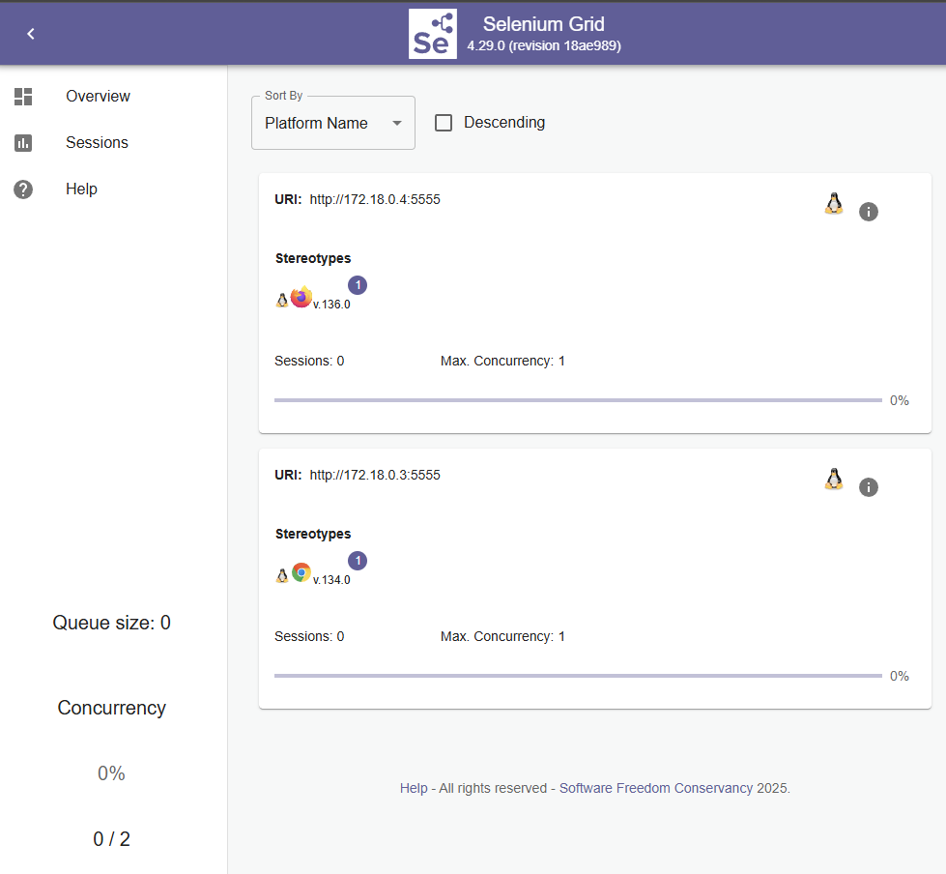
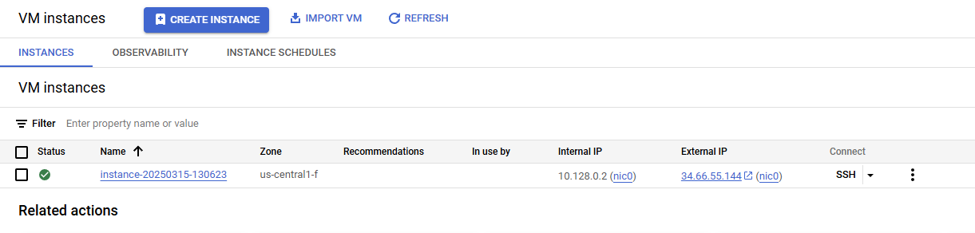
Setting Up Selenium Grid on GCP
Created VM instance and Selenuim Grid
Notes:
To set up Selenium Grid on GCP, we first create a virtual machine, install Docker, and deploy Selenium Hub and Nodes using Docker Compose. Once set up, we verify the installation using the Selenium Grid web interface.

Slide 13
Integration with Jenkins for CI/CD
Step 1: Install Jenkins and required plugins.
Step 2: Create a Jenkins job for Selenium test execution.
Step 3: Configure Jenkins to run Selenium tests in the cloud.
Step 4: Monitor build results and logs for debugging.
Notes:
Integrating Selenium with Jenkins enables continuous testing. We install Jenkins, create a test job, configure it to run in the cloud, and monitor results to ensure smooth execution. This improves automation and efficiency.

Slide 14
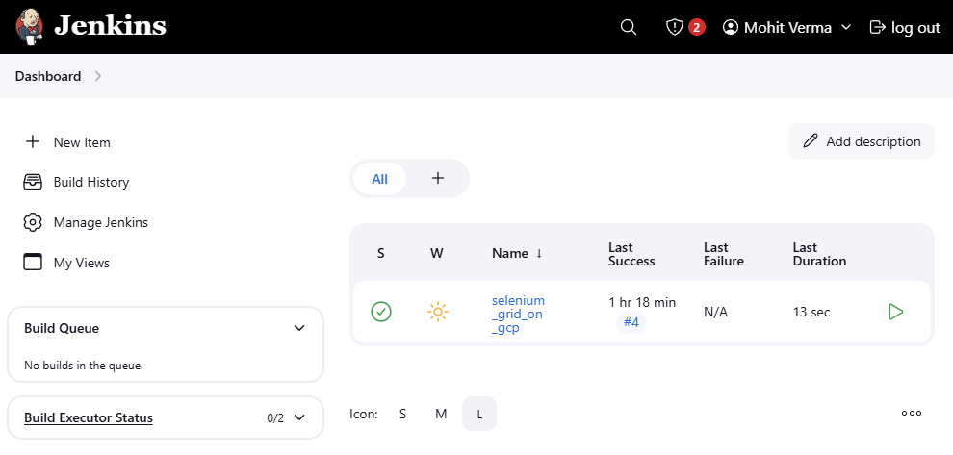
Jenkins dashboard
Notes:
Integrating Selenium with Jenkins enables continuous testing. We install Jenkins, create a test job, configure it to run in the cloud, and monitor results to ensure smooth execution. This improves automation and efficiency.

Slide 15
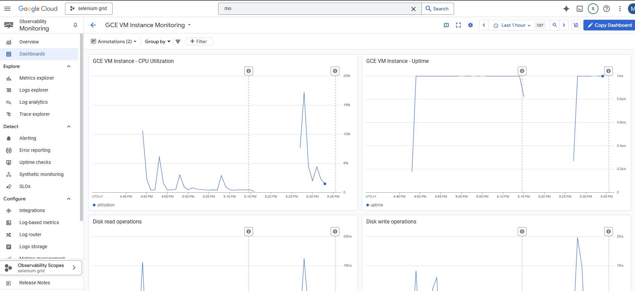
Monitoring VM instance Performance
Notes:
Integrating Selenium with Jenkins enables continuous testing. We install Jenkins, create a test job, configure it to run in the cloud, and monitor results to ensure smooth execution. This improves automation and efficiency.

Slide 16
Demo
Notes:
If you have any more questions or would like to know even more details about our project,
I will give you a few seconds to scan this QR code which links to our full project report.

Slide 17
Answers to Research Questions & Objectives
Deployment & Configuration:
Use GCP Compute Engine to set up Virtual Machines.
Deploy Selenium Grid using Docker containers.
Performance Optimization:
Utilize GCP Cloud Monitoring and Logging.
Optimize test execution by reducing unnecessary browser instantiations. Use GCP Compute Engine to set up Virtual Machines.
Deploy Selenium Grid using Docker containers.
Scalability & Reliability:
Implement Kubernetes for auto-scaling test execution environments.
Use cost-effective solutions like spot instances for scaling test infrastructure.
Notes:
Our research findings provide solutions to key challenges. We deploy Selenium Grid on GCP using Compute Engine and Docker. Performance is optimized using monitoring tools and efficient test script design. Scalability is achieved through Kubernetes and cost-efficient strategies.

Slide 18
Expected Challenges & Mitigation Strategies
Network Latency: Optimize network configurations, choose regional GCP instances.
Security & Compliance: Use secure firewall settings, encryption, and IAM roles for access control.
Containerization: Docker
CI/CD Tools: Jenkins, GitLab CI, GitHub Actions
Programming Language: Python
Notes:
Despite the benefits, deploying Selenium in the cloud comes with challenges. Network latency can be mitigated through optimized configurations. Resource scaling can be handled with Kubernetes, while security is ensured through encryption and IAM roles.

Slide 19
Conclusion & Recommendations
In conclusion, deploying Selenium Grid on GCP enables scalable and efficient testing. Integrating Jenkins improves CI/CD workflows, and monitoring tools help optimize performance. Future work includes Kubernetes-based test execution and AI-driven test optimizations.
Notes:
In conclusion, deploying Selenium Grid on GCP enables scalable and efficient testing. Integrating Jenkins improves CI/CD workflows, and monitoring tools help optimize performance. Future work includes Kubernetes-based test execution and AI-driven test optimizations. Thank you! I am happy to take any questions

Slide 20
Thank you for your time!

